Slide 1
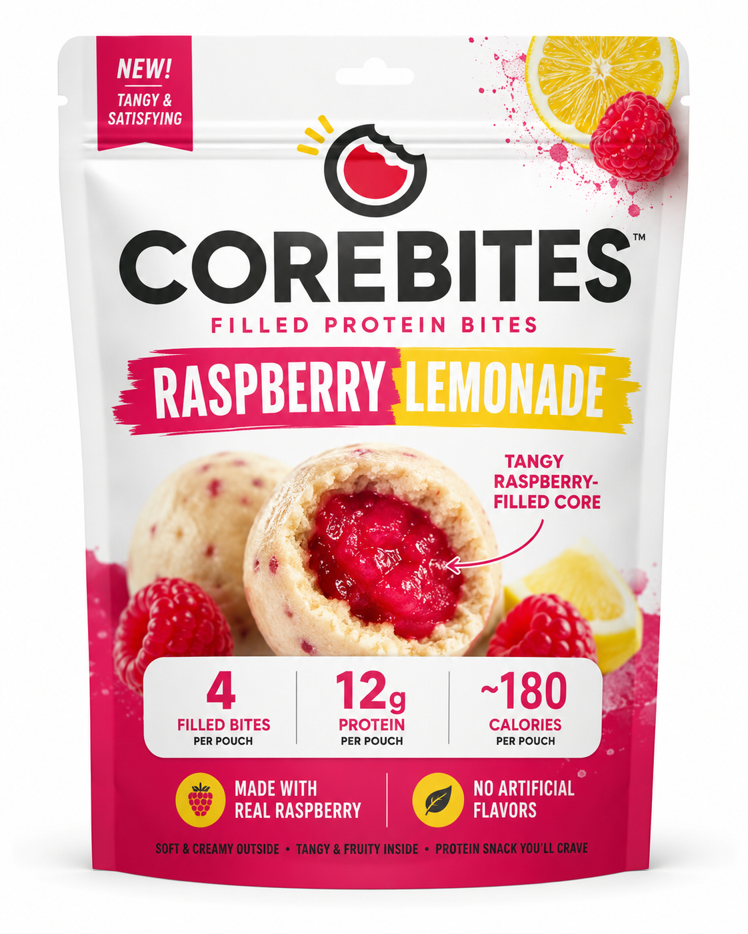
PRODUCT + STORY
CoreBites: the protein snack with a tangy filled core
Soft vanilla-yogurt protein bites with a bright Raspberry Lemonade center — built for busy students and young professionals who want protein without chalky bar energy.
4 filled bites
12g protein
~180 cal
Hero SKU: Raspberry Lemonade
Launch lineup: Strawberry Lime, Blueberry Açaí, Mango Passionfruit, Peach Iced Tea
Ownable visual: break open the bite, reveal the core.
COREBITES / 1

Slide 2
MARKET + GTM + ASK
A focused pilot: tangy flavor momentum + campus fitness occasions
Analyst data: fastest flavor trend
Tangy / vinegar
Boston
25K
$250K
10.9% CAGR
launch city
pilot pouches
pre-seed ask
BBQ / smoky
8.2% CAGR
Go-to-market wedge
Viability score
Sour cream / onion
7.9% CAGR
• Campus stores + fitness studios
• Sampling in the 3pm slump occasion
• Target / Amazon-style volume offers
• Website prototype ready for DTC testing
4.1 / 5
Highest scores: consumer appeal and brand/marketing potential. Biggest risk: product execution — texture, filling stability, shelf life, and COGS.
Insight: translate tangy momentum into a fruit-forward protein snack — Raspberry Lemonade, not another chocolate/peanut butter bar.
COREBITES / 2

Slide 3
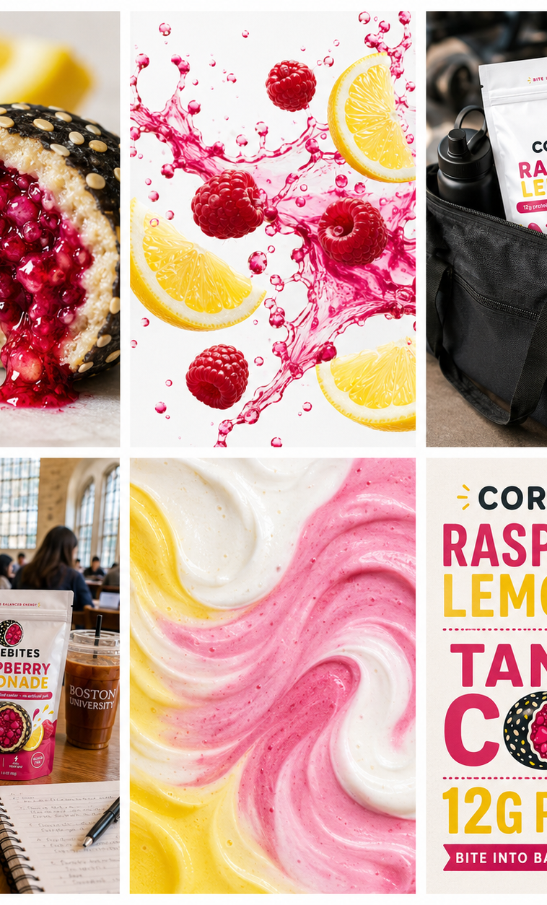

LIVE PROTOTYPE
Live Prototype
https://ai-snack-company.online
A working single-product ecommerce experience designed to validate CoreBites demand before scale-up.
What the website can do
• Show the animated filled-core brand story
• Present Raspberry Lemonade with value cues and volume discounts
• Simulate add-to-cart, checkout validation, and order confirmation
Scan to view
Jingle hook: “Snack goes boom — CoreBites!”
COREBITES / 3

